Slide 1
Analysis of US Census Income Data and Bias in Machine Learning
Ronen Reouveni, Paul Mackanos III, and Kathleen McConnell

Slide 2



Data Attributes
Before any data munging, this data set consisted of approximately 32,561 observations of 15 variables.
>$50,000 income per year
<=$50,000 income per year
Age
Work class
Fnlwgt (# of people census takers believe that observation represents)
Education
Marital status
Occupation
Relationship
Race
Sex
Capital gain
Capital loss
Hours per week
Native country

Slide 3
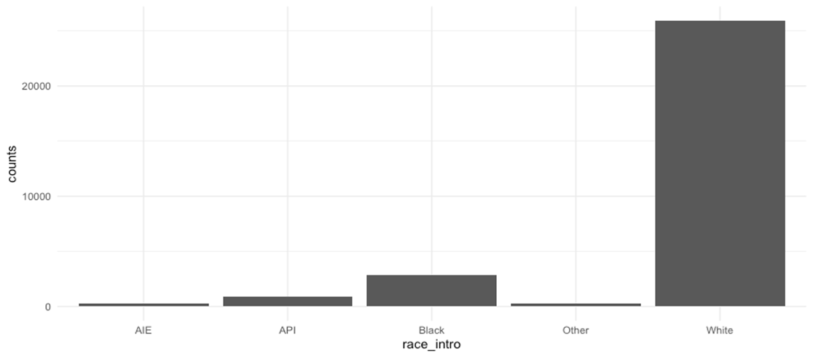
Race Data
Table 1: Counts of each Race Contained in Sample Data
The distribution of race in the source data is very skewed white, a deficiency of samples for other races means training and testing should be set close to 50/50 to get enough samples to test for accurate modeling.
By training on half the data, the model is still stable, but we have enough testing data to examine the bias
Amer-Indian-Eskimo: 286
Asian-Pac-Islander: 895
Black: 2,817
Other: 231
White: 25,933

Slide 4
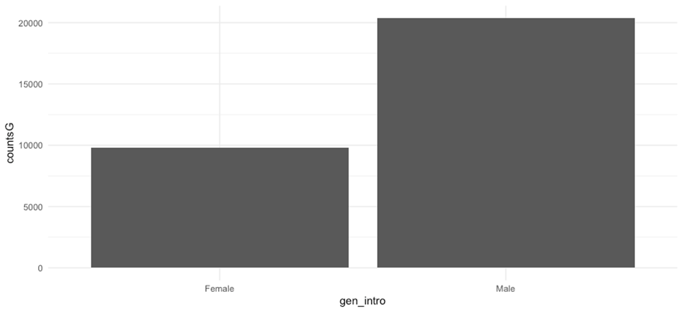
Gender Data
Table 2: Gender Count in Sample Data
The data also skews heavily male. In theory we would think this distribution should be closer to 50/50.
Male: 20,380
Female: 9,782

Slide 5


The Questions
Can we find a bias in the frequency of type II errors given race and gender? A type II error is defined as miss classifying an observation as below 50k a year when they are above 50k a year.
What are the most important predictors according to mean Gini decrease?
What are some of the correlations between those inputs and income?
What is the simplest model we can implement with an error rate of at most 20%?

Slide 6

The Clean Up
This data was extensively studied to determine the usable variables
After this initial analysis, the data set was forwarded to the preprocessing phase, where all the errors in the data were removed to make it usable for further analysis
Made column names consistent
Summarized columns of data
The number of rows in the data set (myCleanData) was 30,162 observations of ​15 variable columns after munging
Reduced observations by 2,399

Slide 7


Modeling Techniques
Code used to install packages and libraries:
> install.packages("randomForest")
> install.packages("pROC")
> install.packages("reshape2")
> install.packages("caret")
> install.packages("ISLR")
> install.packages("tree")
> install.packages("kernlab")
> library(caret)
> library(e1071)
> library(randomForest)
> library(pROC)
> library(ggplot2)
> library(reshape2)
> library(cluster)
> library(ISLR)
> library(tree)
> library(kernlab)
Support Vector Machines
Random Forest
Random Forest for Bias Determination
Correlations
Decision Trees

Slide 8
Support Vector Machines
svm(formula = income ~ ., data = myCleanData[train_idx,
])
Parameters:
SVM-Type: C-classification
SVM-Kernel: radial
cost: 1
Number of Support Vectors: 5574
> svm_noT_pred <- predict(svm_noT, myCleanData[-train_idx,])
> svm_result <- table(svm_noT_pred,myCleanData$income[-train_idx])
> svm_rate <- (svm_result[1,1] + svm_result[2,2])/(svm_result[1,1] + svm_result[2,2] + svm_result[1,2] + svm_result[2,1])
> svm_rate
[1] 0.8474239
> #svm class rate 84.74%
> support2 <- ksvm(income ~., data = myCleanData[train_idx,], kernal="besseldot", kpar = "automatic", C=3)
> support2
Support Vector Machine object of class "ksvm"
SV type: C-svc (classification)
parameter : cost C = 3
Gaussian Radial Basis kernel function.
Hyperparameter : sigma = 0.0778132721216806
Number of Support Vectors: 5422
Objective Function Value : -13281.22
Training error : 0.125787
> supp_pred2 <- predict(support2, myCleanData[-train_idx,])
> supp_result2 <- table(supp_pred2,myCleanData$income[-train_idx])
> supp_rate2 <- (supp_result2[1,1] + supp_result2[2,2])/(supp_result2[1,1] + supp_result2[2,2] + supp_result2[1,2] + supp_result2[2,1])
> supp_rate2
[1] 0.8545852
An excellent tool for classification, novelty detection, and regression
These SVM models show that with 85% certainty, we can classify an observation as above or below $50,000 a year in income
This is important to keep in mind in establishing a baseline as to issues with bias.

Slide 9
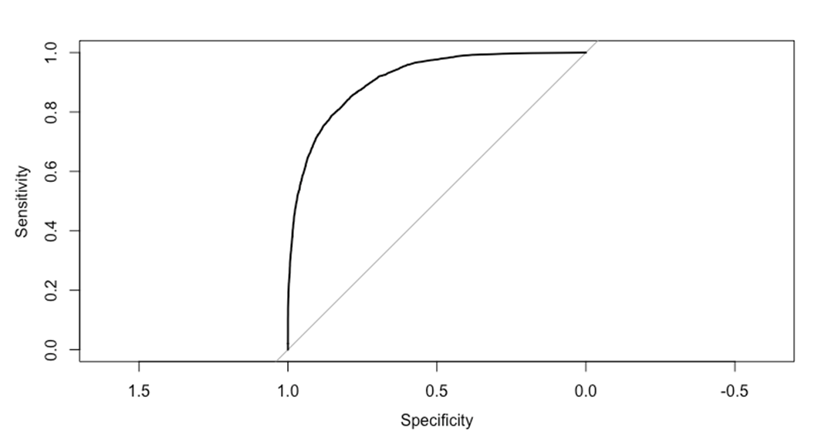
Random Forest
Table 3 ROC Curve1
Performs better than the SVM, and we will, therefore, use it to analyze bias in the following sections
It is crucial to keep in mind these strong classification prediction rates
In a social science setting like this one, 86% accuracy is strong evidence of relationships between the predictors and income
The table shows our model performing well above the 50% trend line. Next, we will see which inputs the Random Forest thought was most important.

Slide 10
Mean Decrease in Gini
rF2$importance
MeanDecreaseGini
age 559.97793
workclass 193.26359
fnlwgt 528.56823
education 334.93850
educationNum 349.64303
maritalStatus 527.79199
occupation 467.10795
relationship 495.83711
race 65.19531
sex 70.30795
capitalGain 577.54788
capitalLoss 164.58231
hoursPerWeek 342.42957
nativeCountry 119.0994
It is the average of a variable’s total decrease in node impurity, weighted by the proportion of samples reaching that node in each individual decision tree in the random forest
Used as a measure of how important a variable is for estimating the value of the target variable across all the trees that make up the forest
A higher number indicates higher variable importance
The most important take away from this is how little importance the Random Forest attributed to race and sex

Slide 11

How to Quantify Bias?
Split Data into training and testing set
Train a Random Forest on the training data
Subset the testing data by race
Use the Random Forest to predict values for the testing data set
Calculate the percent of time the Random Forest predicts under $50,000 a year when the true value is above $50,000 a year
Repeat steps for gender

Slide 12
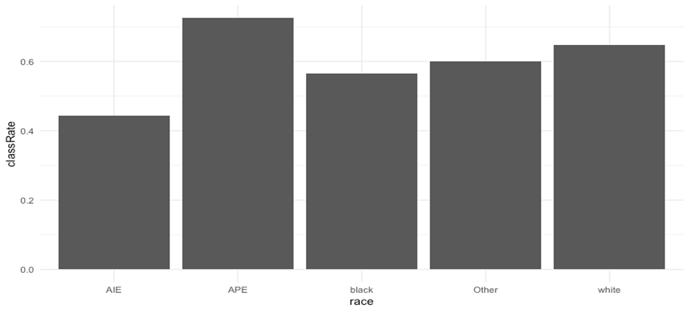
Random Forest Bias Determination
Shows the probability of correct classification for type II
All are below the overall classification rate, but there is a significant difference across races
Table 4: Race Classification Rate

Slide 13
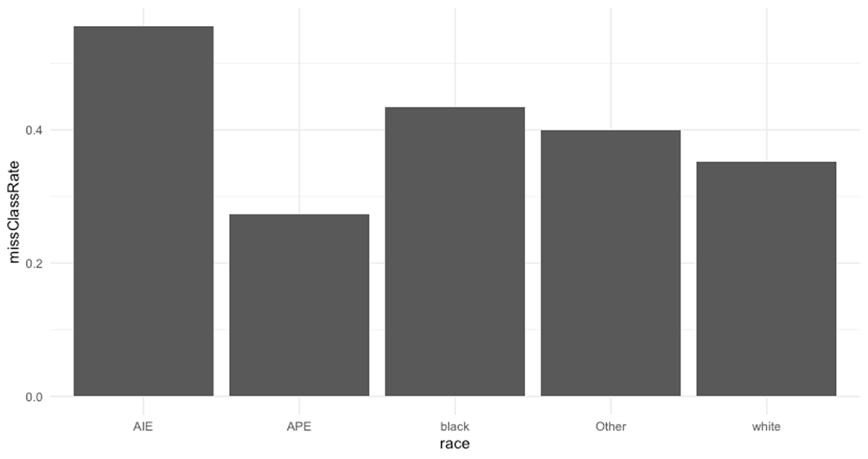
Random Forest Bias Determination, cont.
Table 5: Race Misclassification Rate
Shows the probability of misclassification of being under $50,000 a year when the true value is above $50,000 a year given race
Roughly 20% more likely to be misclassified given American Indian vs. white
Nearly 10% more likely to be misclassified in this setting, given a race of black vs. White
Asian Pacific Islander is the least likely to be miss classified.
Shows significant evidence that we have a bias
Most interestingly, we show these biases despite Gini decrease being almost irrelevant for race

Slide 14
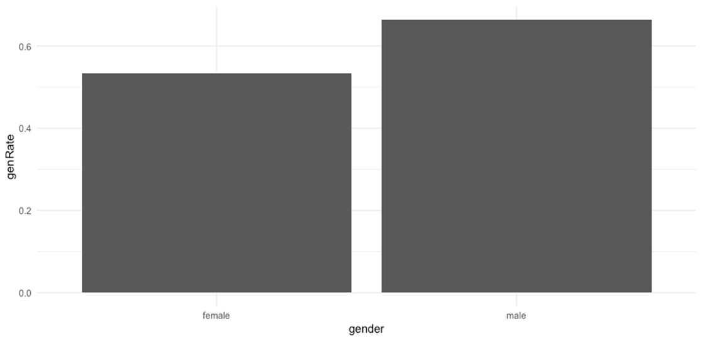
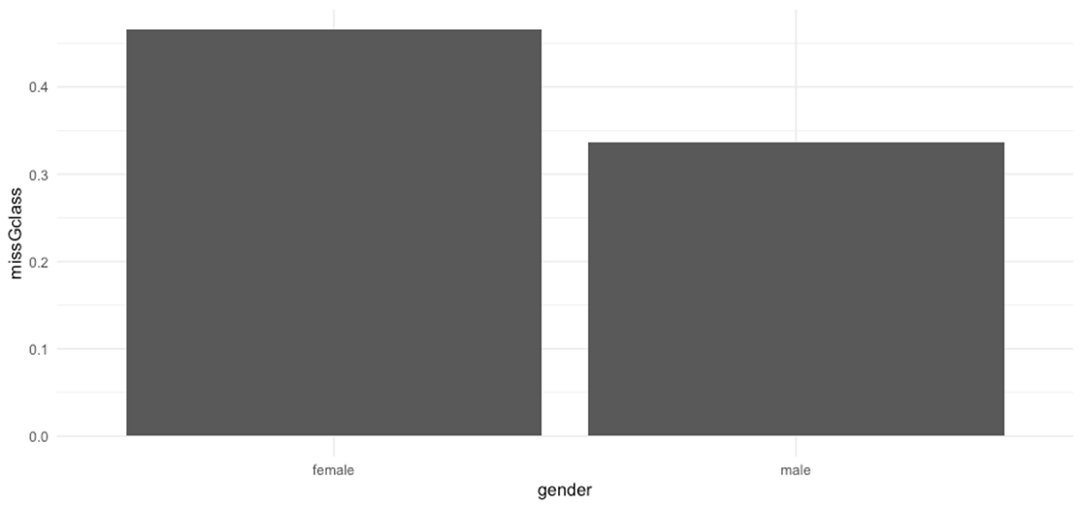
Random Forest Bias Determination, cont.
Table 7: Gender Misclassification Rate
Table 6: Gender Classification Rate
There is a significantly higher chance of being misclassified as under $50,000 than over $50,000 given being a female
The difference between the genders Type II misclassification rate is about 10%
This proves bias results based on race

Slide 15

Correlations
Created a data frame with income and the three variables with the highest Mean Decrease in Gini from our Random Forest outputs. We also added race.
Interestingly, education was not ranked in the four top values in terms of importance.
Pearson Product Moment Correlation
default correlation function in R.
Values for r between +1 and -1 (for example, r = 0.8 or -0.4) indicate that there is variation around the line of best fit.
Biserial Correlation
used to measure the strength and direction of the association that exists between one continuous variable and one dichotomous variable
Since the Pearson's product-moment Correlation (cor and cor.test) produces the same output as running a Point Biserial Correlation (biserial.cor), we continued with the Pearson’s test.

Slide 16
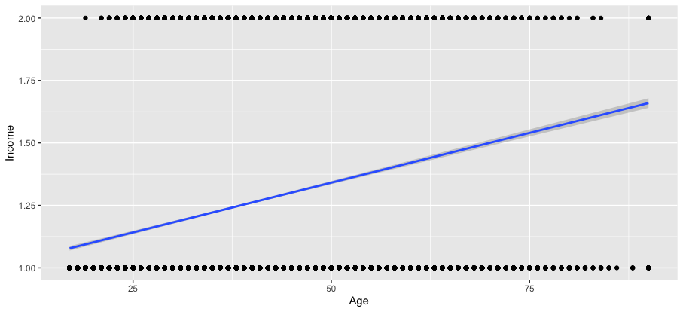
Correlations, cont.
Table 8: Pearson's Product-moment Correlation Coefficient Trend Line (Income and Age)
Intuitive
One of the two top attributes
Pearson's product-moment correlation 0.2419981

Slide 17
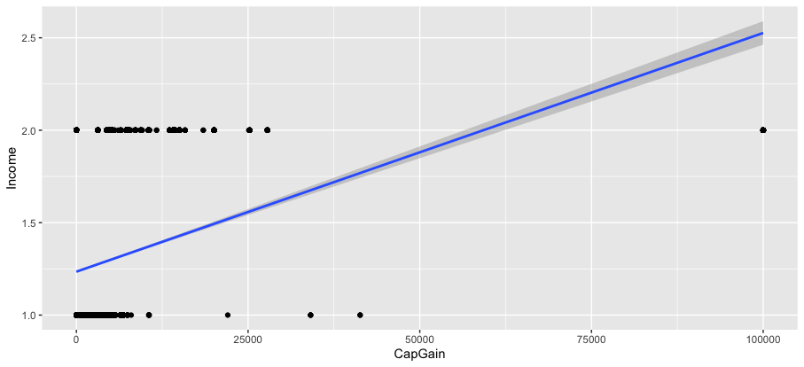
Correlations, cont.
Intuitive
One of two top attributes
Pearson's product-moment correlation 0.2211962
Table 9: Pearson’s Product-moment Correlation Coefficient Trend Line (Income and Capital Gains)

Slide 18
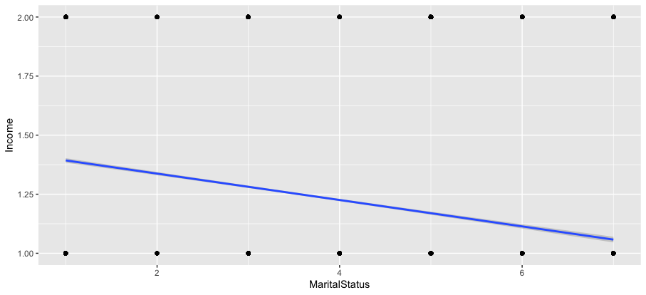
Correlations, cont.
Table 10: Pearson’s Product-moment Correlation Coefficient Trend Line (Income and Marital Status)
1= Divorced, 2= Married-AF-spouse, 3= Married-civ-spouse, 4= Married-spouse-absent, 5= Never-married, 6= Separated, 7= Widowed
Non-intuitive
Would have expected Married or Never-Married to be highest.
Pearson's product-moment correlation -0.1935184

Slide 19
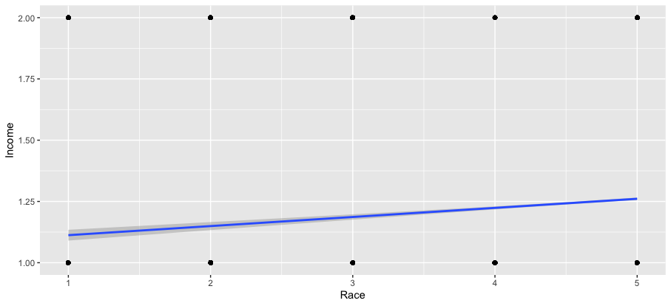
Correlations, cont.
Table 11: Pearson's Product-moment Correlation Coefficient Trend Line (Income and Race)
Income vs. Race
Intuitive
1= Amer-Indian-Eskimo, 2= Asian-Pac-Islander, 3= Black, 4= Other, 5= White
Very small Pearson's coefficient 0.0716576
Not as significant as Age and Capital Gains

Slide 20
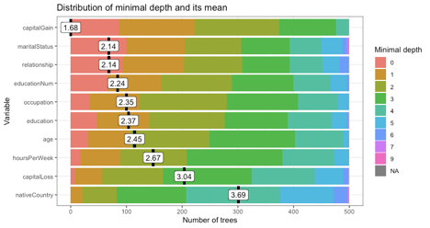
Random Forest Explainer
Table 12:Random Forest Explainer
#devtools::install_github("MI2DataLab/randomForestExplainer")
install.packages("randomForestExplainer")
The minimal depth is how deep into a tree the parameter is used.
#devtools::install_github("MI2DataLab/randomForestExplainer")
install.packages("randomForestExplainer")
library(randomForestExplainer)
min_depth_frame <- min_depth_distribution(rF2)
save(min_depth_frame, file = "min_depth_frame.rda")
load("min_depth_frame.rda")
head(min_depth_frame, n = 10)
tree variable minimal_depth
1 1 age 4
2 1 capitalGain 3
3 1 capitalLoss 2
4 1 education 1
5 1 educationNum 1
6 1 fnlwgt 5
7 1 hoursPerWeek 4
8 1 maritalStatus 5
9 1 nativeCountry 2
1 occupation 3
plot_min_depth_distribution(min_depth_frame)

Slide 21
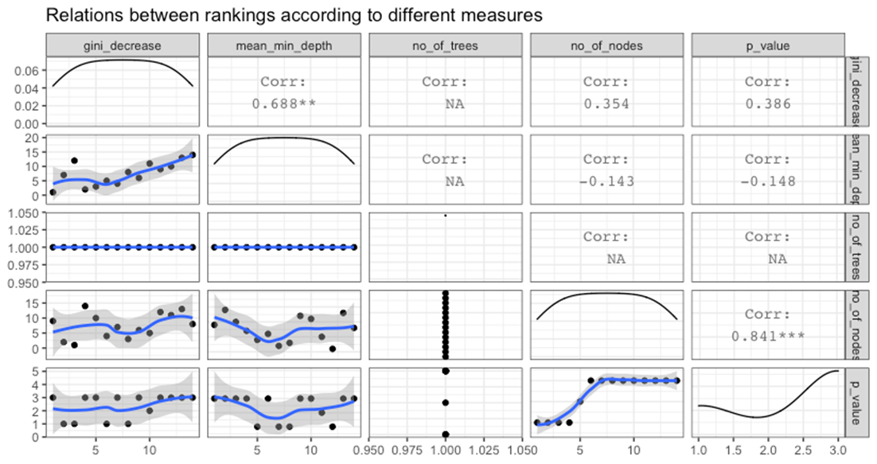
Random Forest Explainer, cont.
Table 13: Importance Ranking Plots

Slide 22
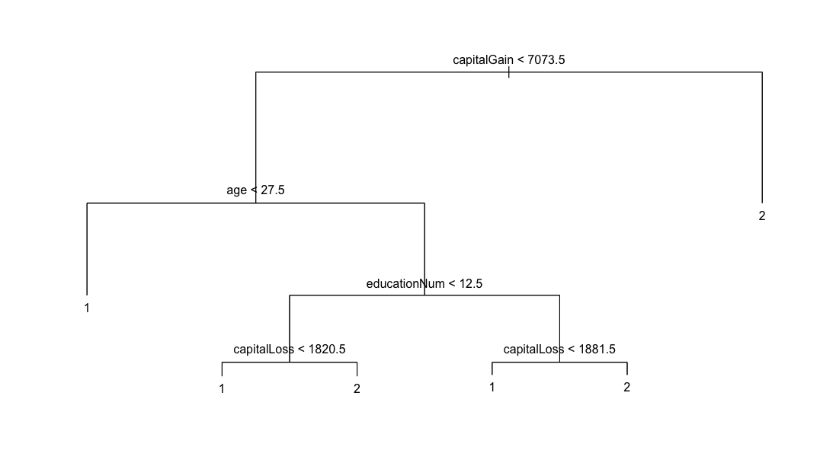
Decision Trees
Table 15: Decision Tree with Integers
This decision tree has a error rate of 19% or a classification rate of roughly 81%
Although our Random Forest performed at closer to 87% this decision tree is extremely intuitive and easy to visualize. It is also the foundation to how a Random Forest works

Slide 23

Finding the Answers
The data tells us there is bias
We could continue to work with this data to find more information
Ex. k fold cross validation
Many attributes are provided however, we focused on race and gender
Found both negative and positive correlations

Slide 24

How is this knowledge useful?
This information would serve lending institutions by revealing areas with bias that have a negative effect on their business or a negative effect on their choice of loanee
A person being misclassified as meeting the approval criteria in error, increases the risk on return of the monies loaned out
A person being misclassified as not meeting the approval criteria would be a lost customer therefore, lost revenue
If a banking institution uses machine learning to approve or deny customers, then they are responsible for the disproportionate amount of people that will be wrongfully denied based on race or gender

Slide 25


Questions?

